Slide 1


Slide 2

Capitalism vs. Communism: A Comparative Analysis
This presentation will compare and contrast capitalism and communism, exploring their definitions, principles, economic, political, and social structures, and highlighting the advantages and disadvantages of each system.
VK
by Vijay Kota

Slide 3

Definition of Capitalism
1
Private Ownership
2
Free Market
3
Profit Motive
Individuals and businesses own and control the means of production.
Competition drives prices, supply, and demand in a market with limited government intervention.
Individuals and businesses seek to maximize profits, motivating innovation and economic growth.

Slide 4
Key Principles of Capitalism
Individualism
Competition
Limited Government
Emphasis on individual rights, freedoms, and self-reliance.
Businesses compete for resources, customers, and market share, driving innovation and efficiency.
Minimal government intervention in the economy, promoting free market principles.

Slide 5

Definition of Communism
Collective Ownership
Classless Society
The means of production are owned and controlled by the state or the collective.
Aiming to eliminate social class distinctions and inequalities.
Central Planning
Government controls the economy, planning production and distribution of resources.

Slide 6




Key Principles of Communism
Social Equality
Emphasis on achieving equality for all members of society, regardless of class or background.
Workers' Control
Workers control the means of production, aiming for a more equitable distribution of wealth and resources.
Abolition of Private Property
Elimination of private ownership of the means of production to prevent exploitation and inequality.

Slide 7
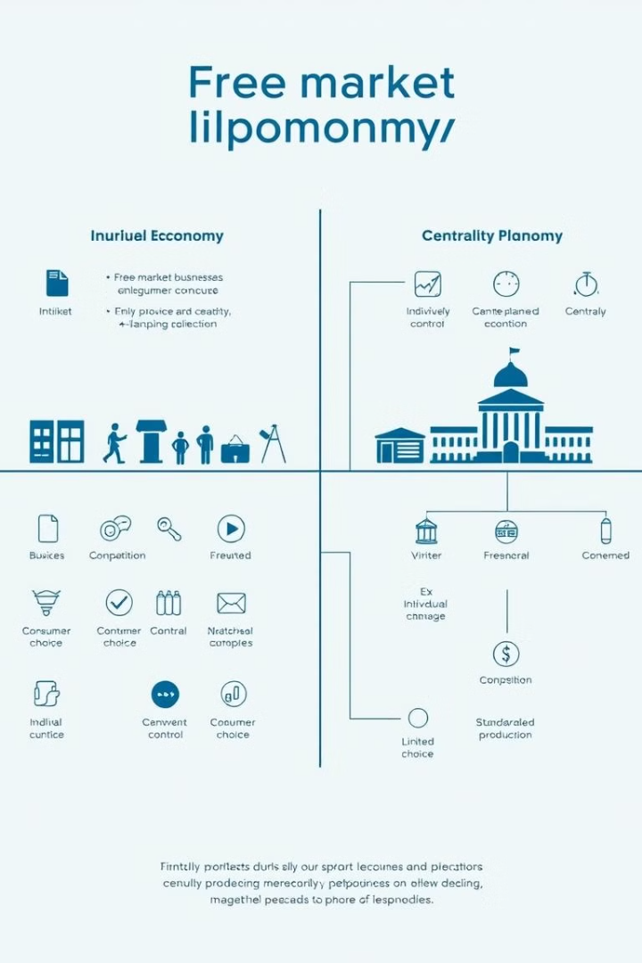
Economic Systems: Capitalism vs. Communism
Capitalism
Communism
Private ownership of resources
Collective ownership of resources
Market-driven pricing
Government-controlled pricing
Profit motive drives production
Meeting societal needs drives production

Slide 8

Political Systems: Capitalism vs. Communism
1
Capitalism
Often associated with democracy, where individuals have the right to vote and participate in government.
2
Communism
Typically characterized by a one-party state or a centralized authoritarian regime.

Slide 9



Social Structures: Capitalism vs. Communism
Capitalism
Communism
Social stratification based on wealth, income, and class.
Striving for a classless society with equal opportunities and resources.

Slide 10


Advantages and Disadvantages of Each System
Capitalism Advantages
Communism Disadvantages
Economic growth, innovation, individual freedom, and consumer choice.
Potential for corruption, lack of incentives, and limited individual freedom.

Slide 11
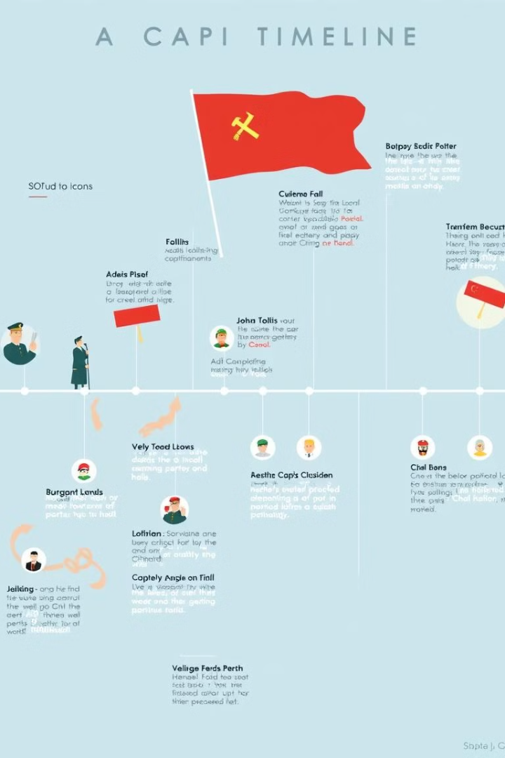
Historical Examples and Case Studies
1
The United States
2
The Soviet Union
A leading example of a capitalist society, with a free market economy and democratic political system.
A historical example of a communist state, with a centrally planned economy and authoritarian rule.
3
China
A complex case study of a country that transitioned from a communist system to a mixed economy with strong market elements.

Slide 12


